Slide 1

Limit Reference Points and the Fish Stocks Provisions
Joint TESA/NOG Workshop
Break-out Group Exercise 1
November 30 2021

Slide 2
Agenda
Questions from yesterday – will save for Friday

Slide 3

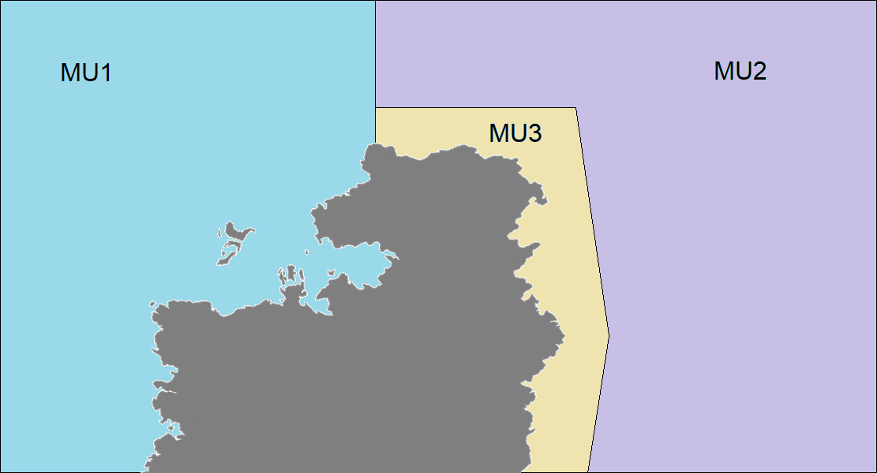
Arctic Sardine
Small pelagic fish
Stock has 3 management units
Defined based on spawning
locations

Slide 4
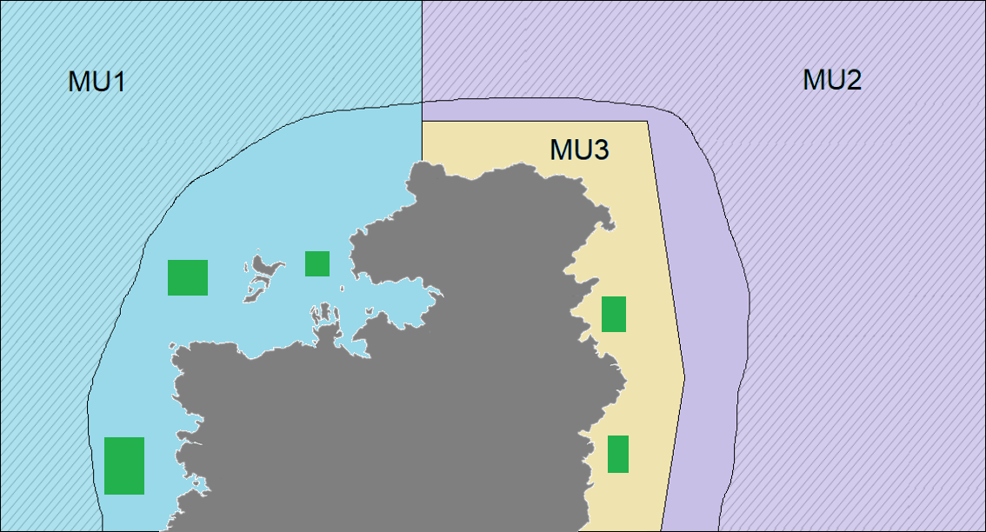
Arctic Sardine
Unknown
spawning
areas

Slide 5
Exercise 1
Exercise Goal:
Identify ways to define an LRP for a data-limited “Arctic Sardine” stock, where the “stock” area contains multiple management units.

Slide 6
Exercise 1
Consider 2 approaches to defining an LRP:
Entire stock (MU1, MU2, MU3)
MU1 only (most data)

Slide 7
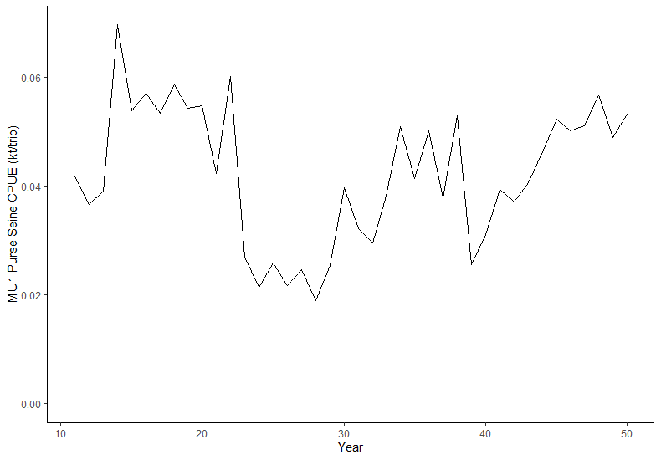
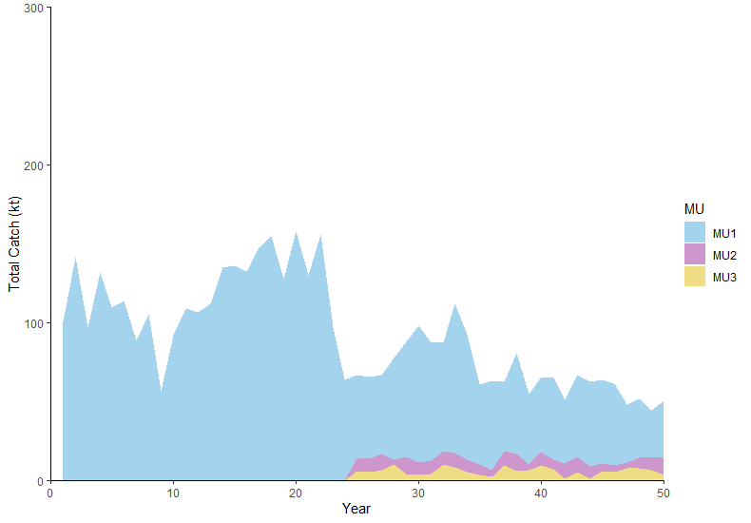
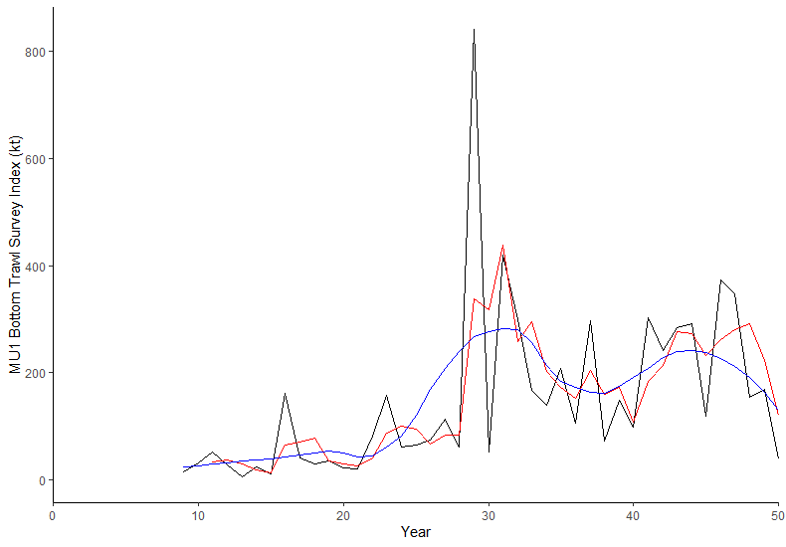
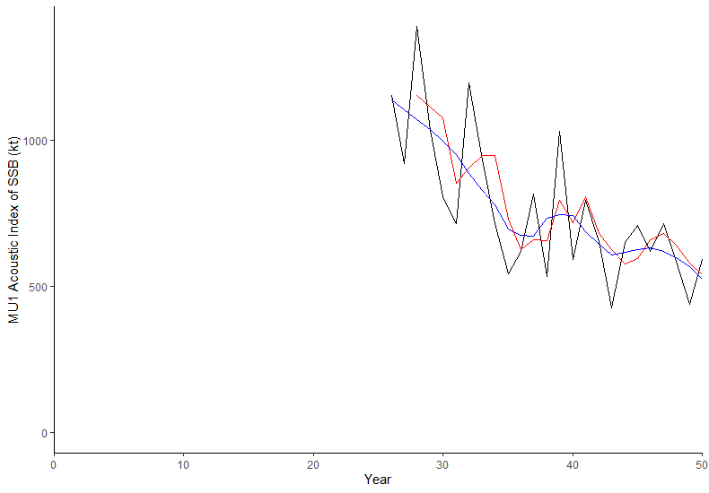
Exercise 1 Data Scenario
CPUE

Slide 8
Exercise 1
Select a spatial area (MU1 or entire stock)
Identify preferred stock status indicator
Identify preferred LRP
Identify status (> or < LRP)

Slide 9
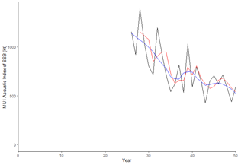


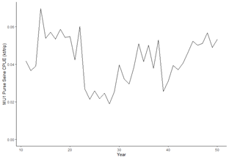

Break Out Group 1
Spatial Area: MU1
Indicator: Acoustic Survey
LRP:
‘stable’ time period of acoustic (years 35-40, or years 35+)
pick a year (i.e. 30) where CPUE was stable
Rationale:
For choice of index:
Designed for the MU1 stock.
Surveys whole stock (on spawning grounds).
Captures majority of biomass that is targeted by harvesters
For LRP options:
Looking across indicators to find a time period with desirable stock signals
Note: Assumed three biological stocks due to spawning site fidelity statement. Also suggested additional analyses.

Slide 10
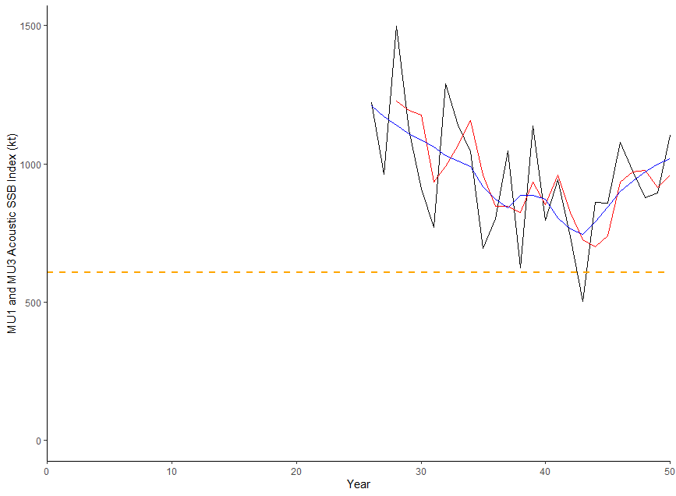
Break Out Group 2
Spatial Area: Stock
Indicator: Acoustic survey index
LRP: Mean of lowest 3 years of time series
Rationale:
-The acoustic index is directly proportional to the abundance of the stock and represents a spatial distribution of spawning stock
-Using the lowest 3 years to set a mean value that the stock has recovered from in the time series.
LRP = 606.33 kt

Slide 11
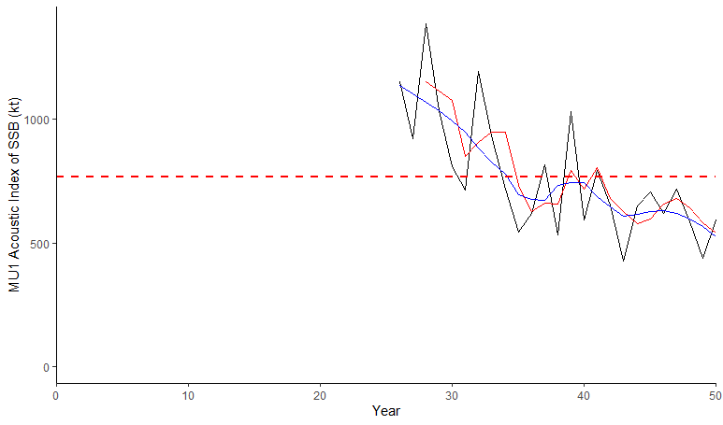
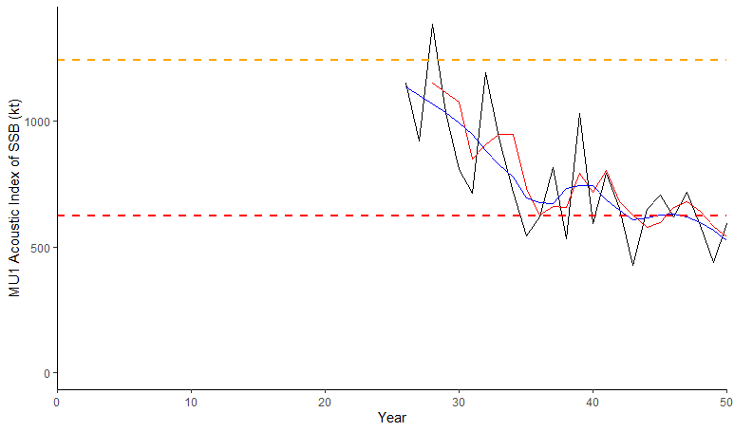
Break Out Group 3
Spatial Area: MU1
Indicator: MU1 Acoustic survey
Candidate LRPs: (i) Average of the time series, (ii) 0.5x desired state (3 higher points), or (iii) average of years 35-40 (not shown)
Rationale: (i) stock likely declined significantly prior to year 25, so entire period wit data could be considered depleted with no evidence of recovery, (ii) beginning of the time period may be considered a desired state, with LRP at half that value, (iii) relative stability in years 35-40 prior to further declines > year 45.
* Suggest repeating for MU3

Slide 12
Break Out Group 4
Spatial Area: MU1
Indicator: Acoustic survey
LRP: To be determined from years of study
Rationale:

Slide 13
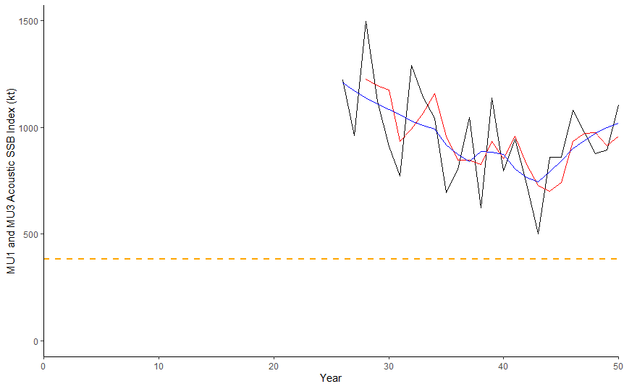
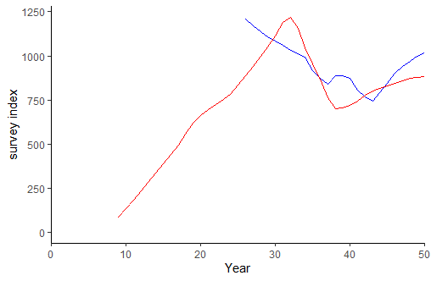
Break Out Group 5
Spatial Area: whole area
Indicator: Acoustic Index MU1&3 summed
LRP: Acoustic Index 40% average (MU1+MU3)=382 kt
Rationale: Acoustic index started well after exploitation began so Brec from index is too high while 20%B0 is too low. Demersal index indicates the stock has been considerably lower in the past and has recovered. Demersal index is roughly consistent with the acoustic index.
Acoustic survey
and LRP
Correspondence
Between Demersal
and acoustic indices

Slide 14
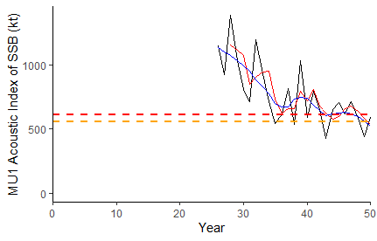
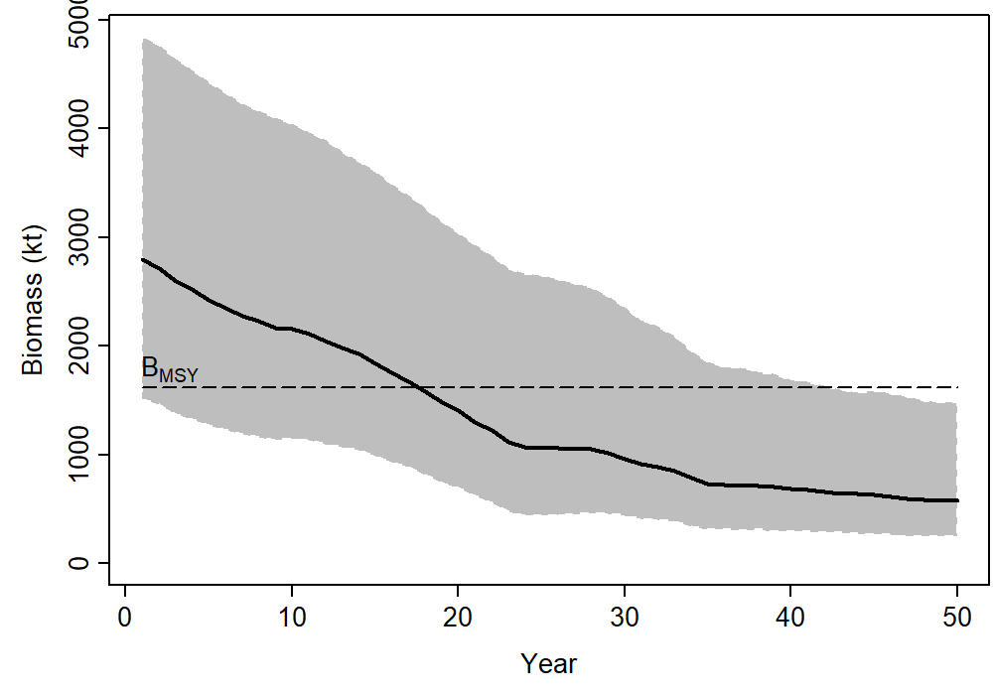
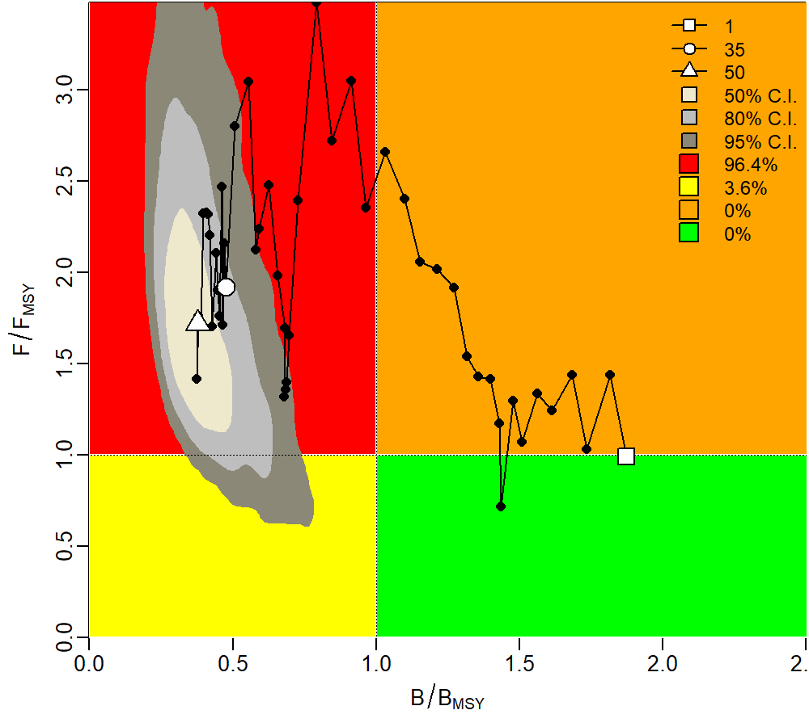
Break Out Group 6
MU1
Spatial Area:
Indicator:
LRP: 40% of estimate for Bmsy
(based on the maximum in the time series)
Rationale: LRP based on data available and time constraints
SSB from Acoustic Index
Orange line = 0.4*max AC Index
Red line = B_{0.4msy} *
* calculated using a Bayesian State Space Surplus Production Model with package JABBA; priors a combination of package efaults and pretty dubious guess work; all blame lies with KL

Slide 15
Break Out Group 6

Slide 16

Exercise 1 Summary from 6 Groups

Slide 17
MU1 Entire Stock

Slide 18
MU1 Entire Stock
Needed more time
Needed more time

Slide 19
MU1 Entire Stock
Historical Proxy for B_{MSY} – max of time series (desirable biomass)
Magnitude ~ 600kt
LRP = 50% max 3 points
Status < LRP
Historical Proxy for B_{MSY} – max of time series
B_{MSY} – surplus production model
Magnitude ~ 600kt
LRP = 40% max point / Model estimated 40% Bmsy
Status < LRP

Slide 20
MU1 Entire Stock
Historical Proxy for B_{MSY} – max of time series (desirable biomass)
B_{Rec} – B recover
LRP = 50% max 3 points
Status < LRP
LRP = Brec = 606 kt Status > LRP
Historical Proxy for B_{MSY} – mean of time series
Historical Proxy for B_{MSY} – max of time series
B_{MSY} – surplus production model
LRP = 40% max point / Model estimated 40% Bmsy
Status < LRP
LRP = 40% mean index = 382 kt Status > LRP

Slide 21
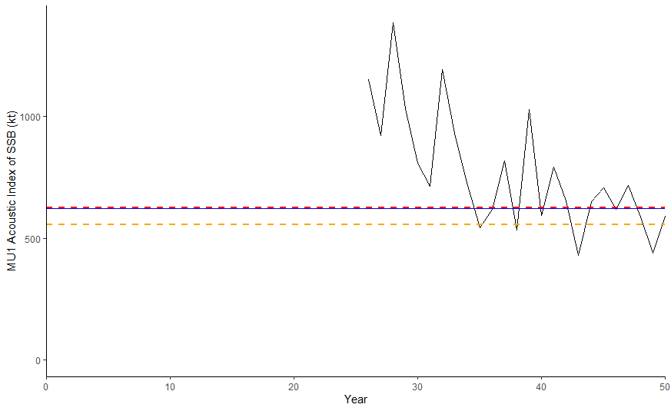
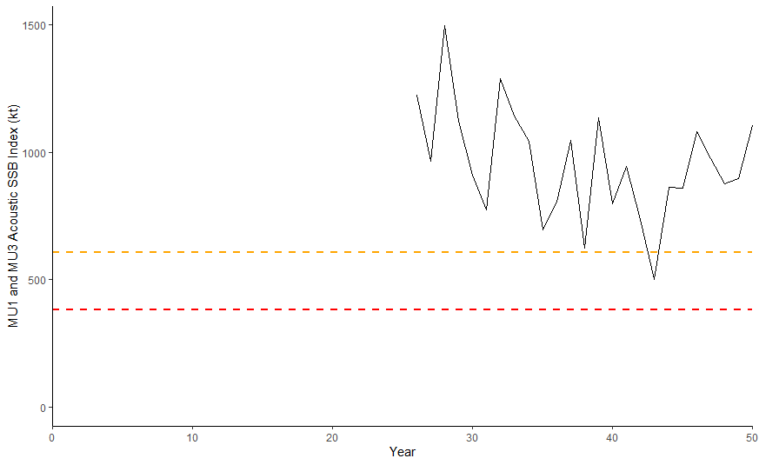
Exercise 1 Summary
LRP options based on acoustic index of SSB
MU1 (left)
MU1 and MU3 (right)

Slide 22
Discussion points
MU1 vs. entire stock
Different trends in index/different status
What is the risk of setting an LRP for the entire stock area?
What were the main challenges?
Any other options?
Assumptions for each approach?
e.g., mean/max in time series as B_{MSY}
B_{recover}
Is there a preferred approach? (Live survey in Teams)
Comments from external experts

